Slide 1
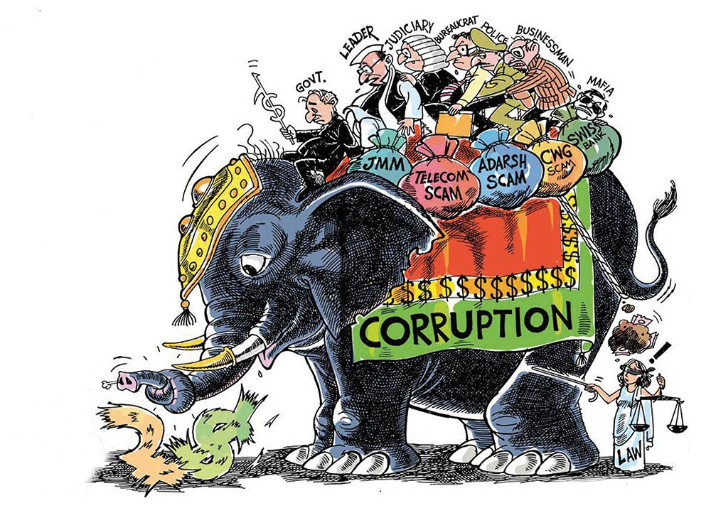
Fighting Corruption in India
Kevin Gustafson

Slide 2
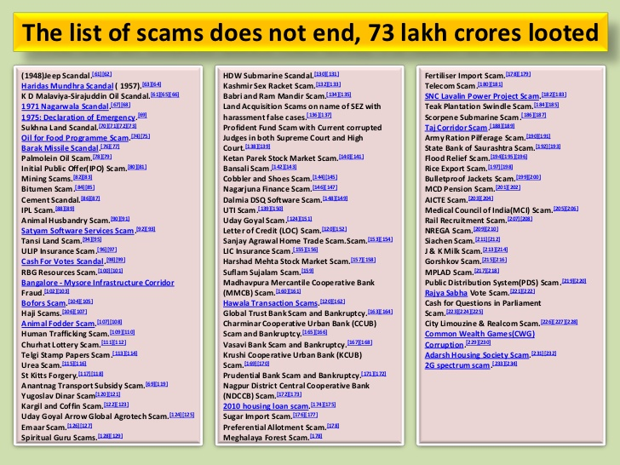
Overview
India ranks 79th among 176 countries in the 2016 Corruption Perception Index released by the Transparency International.
Corruption is widespread – from small graft with police to large procurement schemes
Transparency International and CMS estimate the costs of bribes paid annually for accessing various government services across India to be Rs. 21,000 crore ($210 million).
Informal Economy - India’s underground economy is believed to be 50 percent of the country’s GDP - US$640bn at the end of 2008.
Rs 36,400 crore ($56 billion) due to corruption cases reported in the media from October 2011 to September 2012.

Slide 3
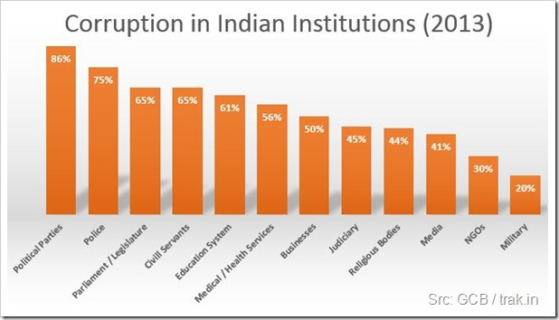
Public Perception of Corruption
The Global Corruption Barometer findings show that the population of India overwhelmingly believe their institutions are corrupt

Slide 4
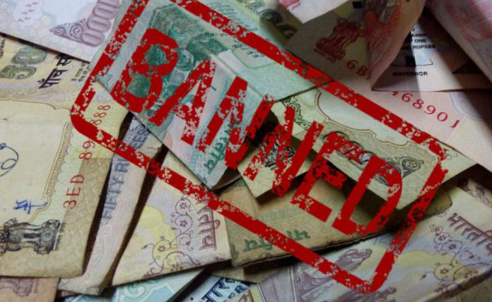
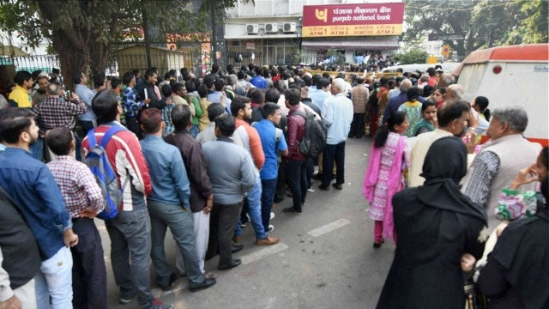
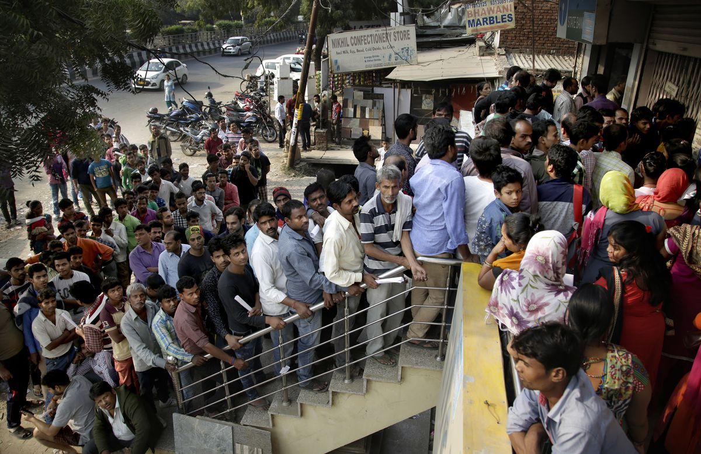
Demonization

Slide 5

Opening for Corruption
From a World Bank survey - the act of obtaining a single construction permit in India involves 27 discrete procedures, takes 162 days, and costs 46 percent of the total cost to a construction firm of building a warehouse.
Lucrative sectors of the economy remain largely untouched by economic reforms, allowing the state to exercise a heavy hand through its regulatory authorities as well as the market power of public sector undertakings (PSUs).
Reserve Bank of India (RBI) Governor Raghuram Rajan has noted, the state in India continues to dominate the “commanding heights,” such as oil and gas, mining, and heavy industry.
The government agencies in charge of administration and law and order are overburdened, inadequately staffed, and often poorly equipped. Thus implementing complex rules and policies, as well as catching and punishing rule-breakers, is a massive challenge.

Slide 6
Enforcement Problems
India has the lowest rate of police officers per capita—122.5 per 100,000 people—of any G-20 member state. Yet even with this low base, a quarter of police vacancies across the country are unfilled. For certain states, the vacancy rate veers on the alarming: Uttar Pradesh, for example, which faces serious law and order difficulties, has nearly 60 percent of its police posts unfilled.
The judiciary faces the same dilemma: almost 30 percent of seats on High Courts across the nation are vacant, in addition to 22 percent of seats in district and subordinate courts. Only the Supreme Court seems to be free of this malaise, as the corresponding rate there is only 6.5 percent.
One of the main consequences of these judicial vacancies is that it takes an inordinately long time to resolve cases. This fact should come as no surprise to anyone in India, but the figures do not make for enjoyable reading. As of 2011, approximately 24 percent of court cases had been pending for at least five years, while nine percent had been pending for more than ten years.

Slide 7
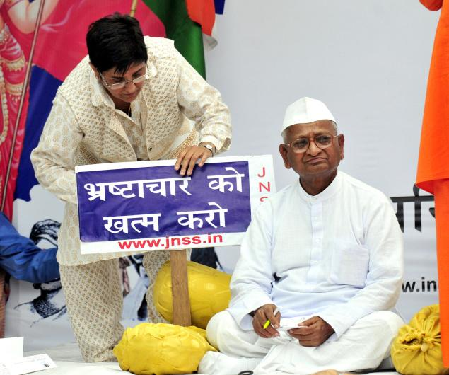
Anti-Corruption Efforts
Anna Hazare – Indian social activist
April 5, 2011 Hazare began a hunger strike at the Jantar Mantar in New Delhi.
Many joined him and a wave of protests began
Urged for a “Lokpal” bill
Increased awareness and produced a version of the Lokpal bill.

Slide 8
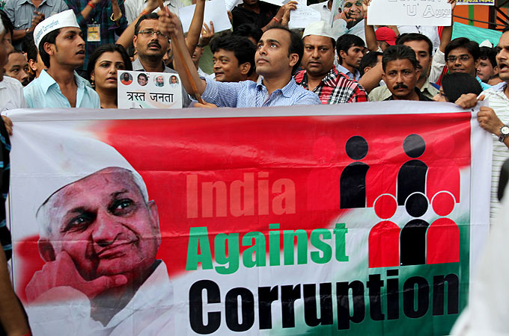
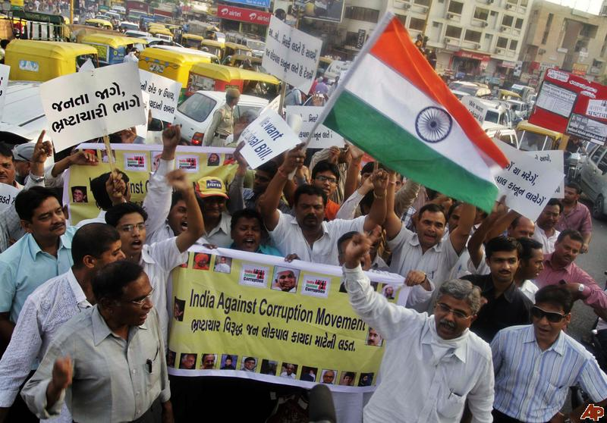
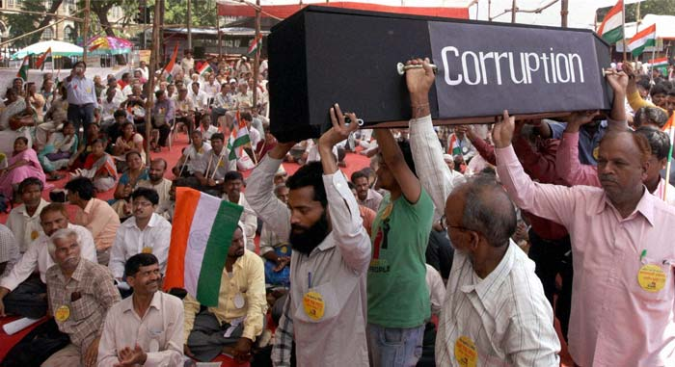
2011 Anti Corruption Protests

Slide 9

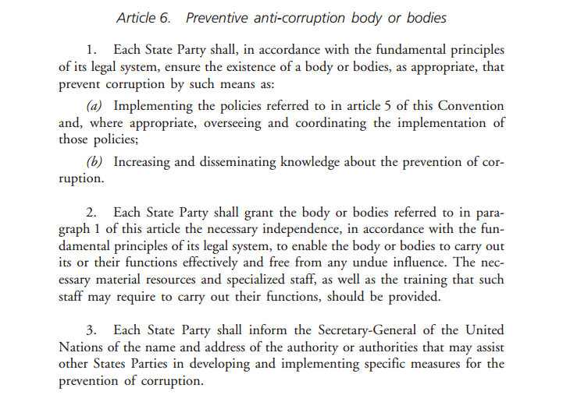
International Best Practices for ACC

Slide 10
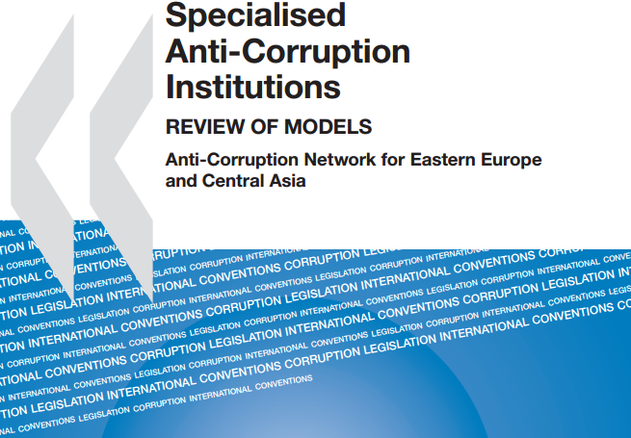
OECD Framework
Three Kinds of ACCs
1) multi-purpose agencies that represent the most common model of a single-agency approach. Some of the first ACCS the Hong Kong Independent Commission against Corruption and the Singapore Corrupt Practices Investigation Bureau follow this model, combining the aspects of repression and prevention under one roof.
2) A law enforcement agency model which focuses on detection, investigation, and prosecution of corruption cases, common in Western Europe.
3) Preventive, policy development and co-ordination institutions which focus more on corruption-related research, coordination of anti-corruption policies and action plans, monitoring conflict of interest regulations, elaboration of codes of conduct, facilitation of trainings, etc, found in France, India, Albania and Montenegro.

Slide 11
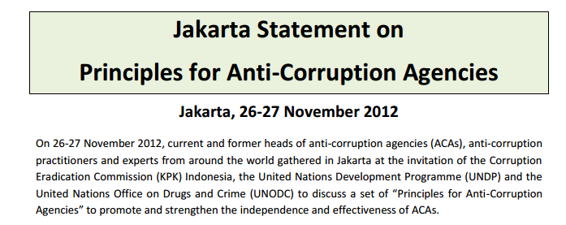
MANDATE: ACAs shall have clear mandates to tackle corruption through prevention, education, awareness raising, investigation and prosecution, either through one agency or multiple coordinated agencies;
COLLABORATION: ACAs shall not operate in isolation. They shall foster good working relations with state agencies, civil society, the private sector and other stakeholders, including international cooperation;
PERMANENCE: ACAs shall, in accordance with the basic legal principles of their countries, be established by proper and stable legal framework, such as the Constitution or a special law to ensure continuity of the ACA;
APPOINTMENT: ACA heads shall be appointed through a process that ensures his or her apolitical stance, impartiality, neutrality, integrity and competence;
ADEQUATE AND RELIABLE RESOURCES: ACAs shall have sufficient financial resources to carry out their tasks, taking into account the country’s budgetary resources, population size and land area. ACAs shall be entitled to timely, planned, reliable and adequate resources for the gradual capacity development and improvement of the ACA’s operations and fulfillment of the ACA’smandate;
INTERNAL ACCOUNTABILITY: ACAs shall develop and establish clear rules and standard operating procedures, including monitoring and disciplinary mechanisms, to minimize any misconduct and abuse of power by ACAs;
EXTERNAL ACCOUNTABILITY: ACAs shall strictly adhere to the rule of law and be accountable to mechanisms established to prevent any abuse of power;
PUBLIC REPORTING: ACAs shall formally report at least annually on their activities to the public.
PUBLIC COMMUNICATION AND ENGAGEMENT: ACAs shall communicate and engage with the public regularly in order to ensure public confidence in its independence, fairness and effectiveness

Slide 12
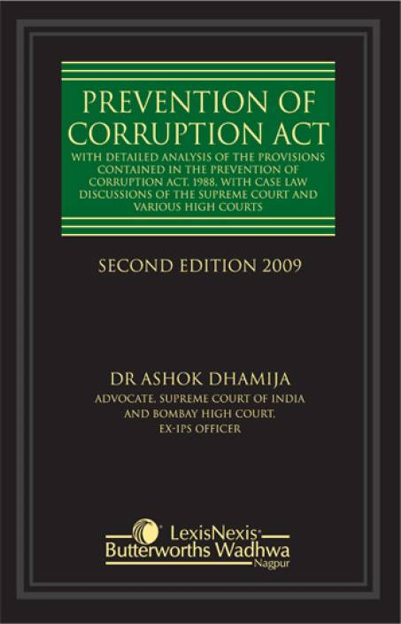
Anti-Corruption Laws in India
Prevention of Corruption Act of 1987
Makes the act of accepting or giving a bribe to a public official to be illegal. Defines public official broadly.
Mandates that investigations be undertaken only by those of high rank.
Allows for the Appointment of special Judges if necessary.
Punishable with imprisonment which shall be not less than 6 months but which may extend to 5 years and shall also be liable to fine.

Slide 13
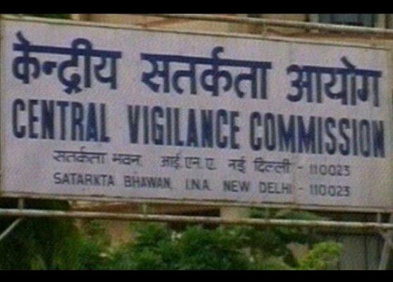
Anti-Corruption Laws in India
In the early 1960s, the government established the Central Vigilance Commission.
The goal of the CVC was to be an internal governmental watchdog agency to prevent corruption from within.
In 2003, the Indian parliament enacted the CVC Act aimed at broadening the scope of the CVC. Prior to the 2003 bill, the CVC had little to no actual power.
Places a Central Vigilance Officer to government agencies to identify corrupt practices and proposes investigations
Cannot carry out investigations on its own

Slide 14
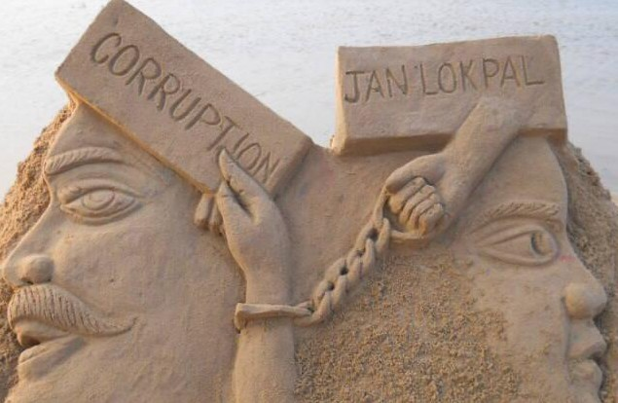
Anti-Corruption Laws in India - LLA
Lokpal and Lokayukta Act (LLA)
The Lokayukta is an anti-corruption ombudsmen originally established in Maharashtra decades prior to inquire into allegations of corruption against certain public functionaries.
Widely popular.
The LAA mandates the establishment of a Lokpal for the Union and Lokayukta in each state.
While locally, the investigation of corruption is given to the Lokayukta, nationally the Lokpal has the jurisdiction to inquire into all complaints arising from the PCA against certain public functionaries, namely high offices such as incumbent or past Prime Ministers, Union Ministers and any person who is or has been a member of the national parliament.
The LLA provides the Lokpal with more than just investigatory powers. Indeed, after the completion of investigation, the Lokpal can itself initiate prosecution against the accused and/or impose penalties via its prosecution wing or initiate prosecution in the special court proposed to be established to try offences under the PCA.

Slide 15
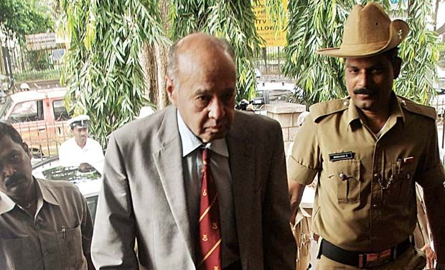
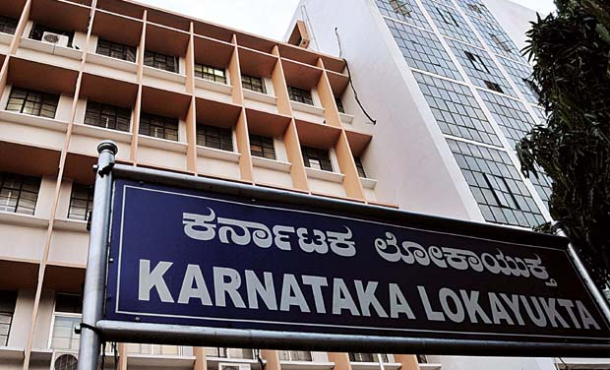
Evaluating India’s ACCs

Slide 16
India’s Tripartite Anti-Corruption Scheme

Slide 17
Evaluating India’s ACCs – The CVC
The Central Vigilance Commission
In the central government, each ministry/organization has a CVO who monitors and takes action on irregularities in the organization and reports them to the CVC.
Though there have been high profile cases by the CVC, significant limitations remain.
The CVC is only an advisory body and central government departments are free to either accept or reject CVC's advice in corruption cases. (Mandate)
The CVC does not have adequate resources compared with number of complaints that it receives. It is a very small set up with a sanctioned staff strength of 299. Whereas, it is supposed to check corruption in more than 1500 central government departments and ministries. (Under funded and staffed)
The CVC cannot ask for the initiation of inquiries against any officer of the level of Joint Secretary and above on its own and must seek permission from the concerned department. The appointment process is also not independent. Though the leader of the Opposition is a member of the Committee to select CVC and VCs, the Committee considers candidates put up before it, thereby making appointments to CVC indirectly under the control of Government of India. (Independence)

Slide 18
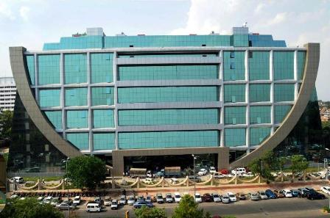
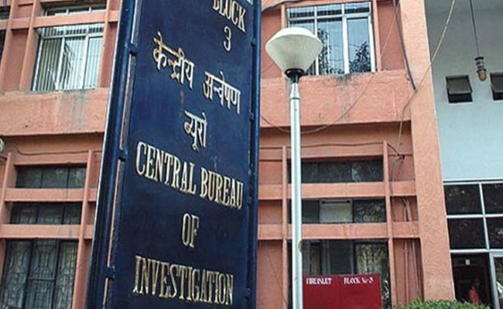
Evaluating India’s ACCs – The CBI
The Central Bureau of Investigation
Indian’s Central Bureau of Investigation is its national police force. Established in 1941, the CBI was created for the specific task of addressing corruption. Since then, the role of the CBI has grown to be more like a national police force and then corruption work was relegated to a division inside the CBI. After the passage of the Prevention of Corruption Act the CBI was given new powers to investigate claims against officials. In this role, the CBI remains Indian’s primary anti-corruption agency.

Slide 19
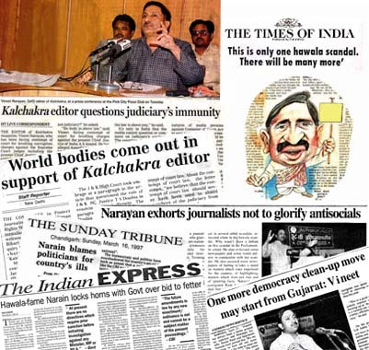
Evaluating India’s ACCs – The CBI
The CBI remains Indian’s primary anti-corruption agency.
The independence of the CBI, or lack of it, is an issue outlined by the Supreme Court in its landmark Vineet Narain case. The Court gave extensive directions to the government to secure the independence of the CBI and the Enforcement Directorate (ED), and granting the CVC more of a role in oversight of the CBI.
Looked on as a positive step, even Narain admits, little progress has been made.
Under the current setup, the independence or autonomy of the CBI will always remain something of a myth. The CBI remains constrained as it needs sanctions for prosecuting corruption cases against public servants and in some situations it even needs permission to even register cases.
The government must grant approval if the CBI loses a case in the trial court and wants to appeal to the higher court.
During the last decade, at least four former Directors of the agency have been given high-level government positions such as appointments as State Governors. Senior level CBI officers come from the Indian Police Service who owe their allegiance to their employer - the government.
While the CPA demands that only a high ranking police officer can investigate corruption cases, these are the same people who may owe their position to those in authority, it leave open a high possibility for corrupting influences to shape the investigations.

Slide 20
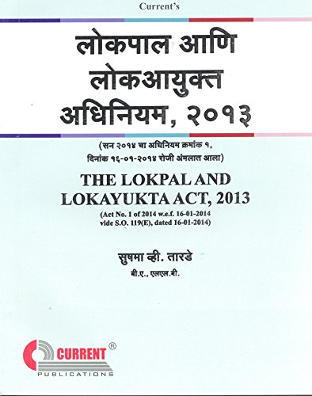
Evaluating India’s ACCs - LokPal and Lokayukta Act
The Lokpal law came into force on January 16, 2014.
The law gives the Lokpal the power to investigate complaints against the Prime Minister, other ministers, current and former legislators, government employees, employees of firms funded or controlled by the Centre, societies and trusts that collect public money, receive funds from foreign sources, and have an income level above a certain threshold.
Inquiries are to be completed within 60 days and investigation to be completed within six months. Inquiry against the Prime Minister has to be held in-camera and approved by two-thirds of a full bench of the Lokpal.
The Lokpal will exercise superintendence over the CBI in relation to the cases referred by it. CBI officers investigating cases referred by the Lokpal can be transferred without its approval.
The Lokpal can initiate prosecution through its prosecution wing before a special court. Lokpal-initiated trials are to be completed within two years.
However, the Lokpal has yet to be established and no cases have yet been investigated.
States have control over Lokayukta legislation, but in practice, the heads of the local Lokayuktas are picked by governors of the state and must be former supreme court judges.

Slide 21
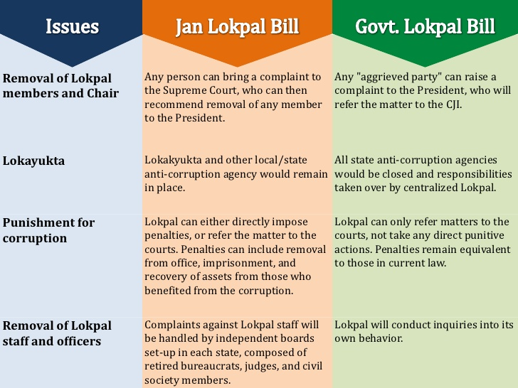
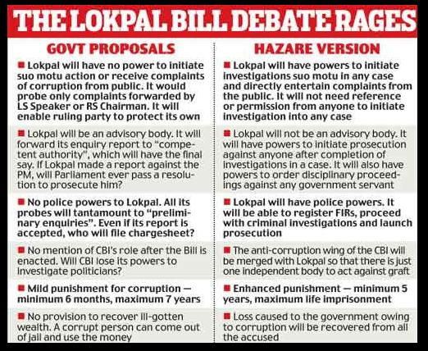
Evaluating India’s ACCs - LokPal and Lokayukta Act

Slide 22
Fighting Corruption in India –
Conclusions and Reccomendations
Corruption in India remains widespread and endemic.
India’s current Tripartite scheme is ineffective, cumbersome, and not in line with international best practices.
None of the ACCs in India are adequately staffed and funded. All three lack the independence necessary to tackle corruption and remain, for much of the population, wholly inaccessible.
The Indian government must adequately support what anti-corruption efforts are currently being conducted, but;
The Indian government should enact Hazare’s Lokpal bill which would:
Merge the CVC, CBI anti-corruption unit and Lokayukta/Lokpal into a single agency;
Provide independence to the Lokpal.
Provide adequate procedures and independence as well as public engagement.

